Slide 1
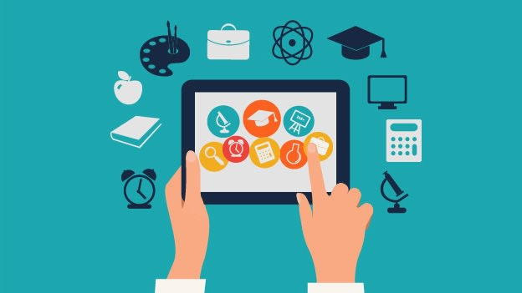
E – learning
Deep dive into e - learning
This Photo by Unknown Author is licensed under CC BY-SA-NC

Slide 2
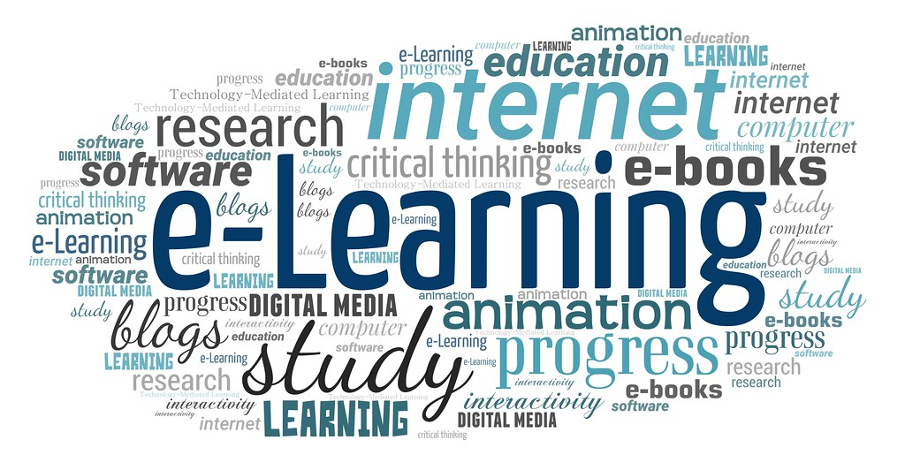
Programming languages used:
HTML
CSS
Bootstrap
JavaScript
MySQL
PHP
This Photo by Unknown Author is licensed under CC BY

Slide 3

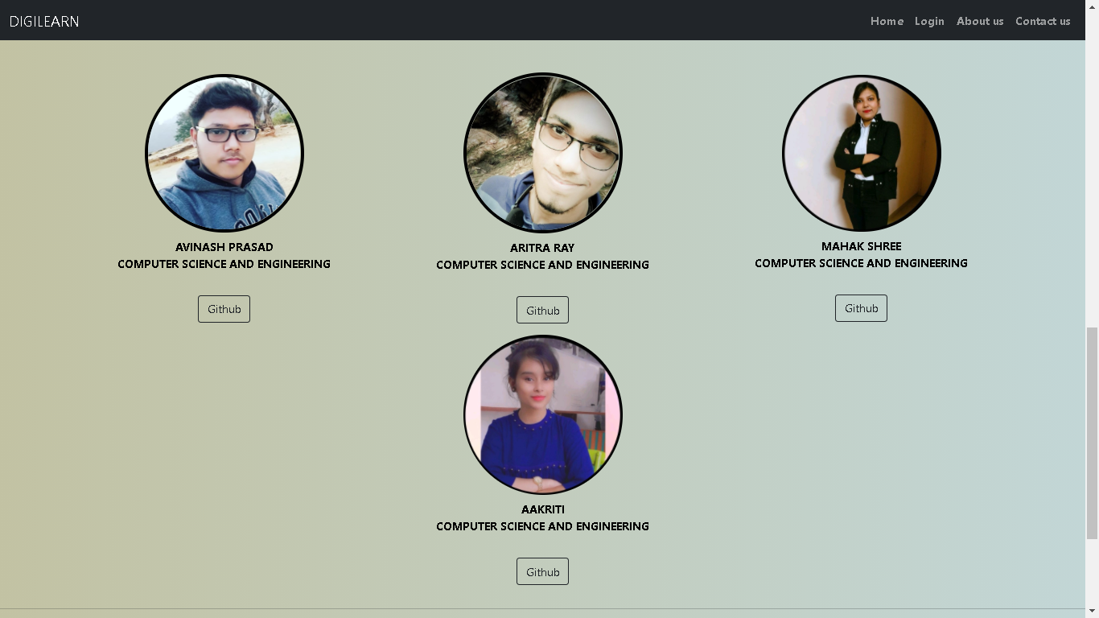
MEMBERS

Slide 4
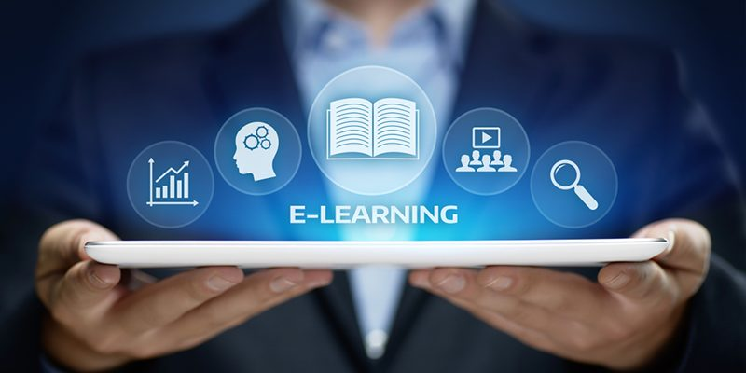
About e-learning
e-learning is basically a learning that is enabled electronically among different generations.
It can be said in a way that students of different generations learn , think and connect differently.
Younger generations have grown up thinking , learning and communicating while being connected with the technology . Likewise , older generation students have adapted their own way of thinking , learning and connecting .

Slide 5
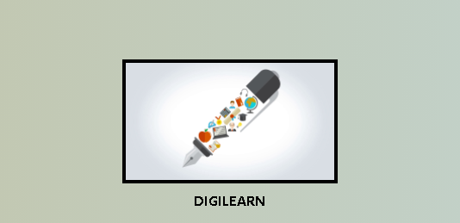
About Digilearn
DIGILEARN is an e-learning platform where any generation of people can learn anything without any interruption. In this platform five different types of generations, viz Elementary school group, Middle school group, High school group, Corporate group, and Elder group.
In elementary group, kids can learn about alphabets, counting numbers and a bit of rhymes. They can also learn about hygiene.
In Middle group, children can learn about basics of computer.
In High group, students can learn about mark-up language and programming language like python.
In Corporate group, professionals can learn about advanced form of scripting and programming language.
In Elder group, senior citizen can learn about computer parts, openining and closing files and applications, basics of internet surfing and e-mail usage, a bit about creating and saving documents, and fitness/yoga.

Slide 6
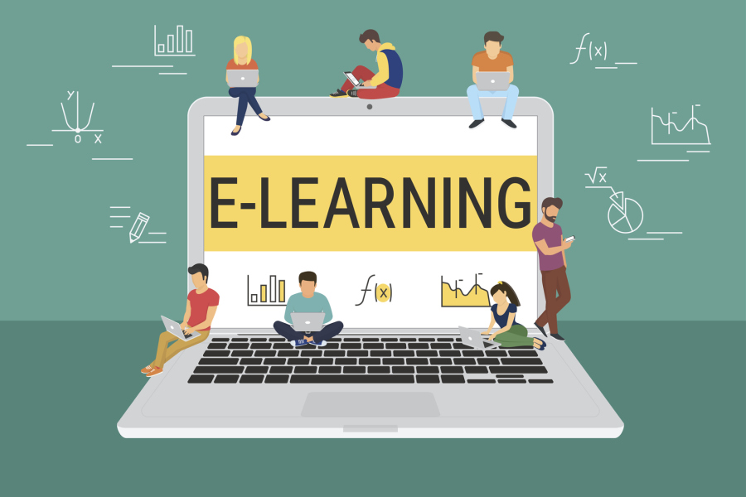
Key points for source creators
Course creators can use the data available to shape as to what each student needs before the launching of e-learning platform.
For the novice students , easy approach to learning can be taken through animations and periodic supervision.
Additional work should be assigned to students to evaluate their understanding of concept .
Platform should be engaging and easily assessable by the students.
Feedback option should be made available to know the deficiency of the platform.
Weekly report of student’s progress should be made available and they should be monitored regularly.
Platform should be made in a way that it promotes the working of student and teacher together.
This Photo by Unknown Author is licensed under CC BY-SA

Slide 7



Epitome of e-learning
Synchronous e-learning
-> It’s a real time learning , learners and teachers interact online at the same time from different localities. It’s more effective as the participants can share the ideas and interact at the real time . Detailed queries and solutions to the problems are provided during the session .
The best ways to connect is through :
Virtual classroom
Audio and video conferencing
Webinars
Application sharing

Slide 8
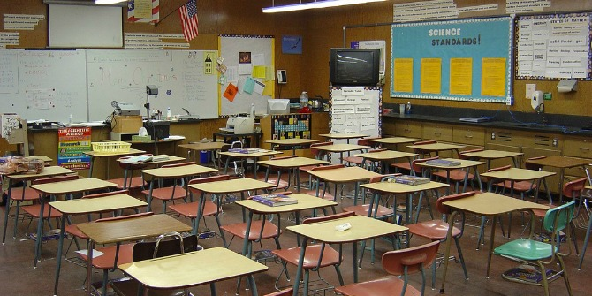
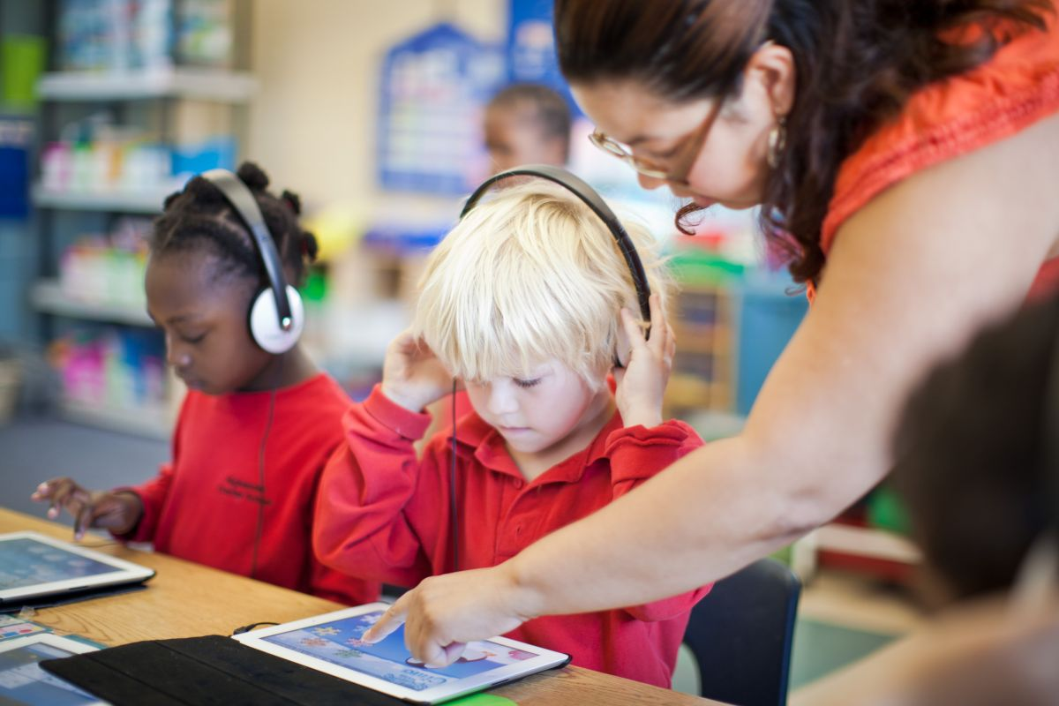

Epitome of e-learning
2. Asynchronous e-learning
-> It’s a pause and resume kind of learning . The learner and the educator may not be online at the same time . Learners can access the content anytime through downloading the documents . Learning can be done at the preferable time of the learners by not affecting their daily routine .
It can done through :
E – mails
Blogs , discussion forums
E-books , CD’s , DVD’s

Slide 9



Epitome of e-learning
3. Blended e-learning
-> It combines the best of two training environments – traditional face to face classroom training and hi-tech e-learning . It engages both , millennials who are most used to digital learning and traditional learners serving them both .
Some of the blended learning methods:
Face to face
Through games
Online established labs
Online drivers-mails

Slide 10

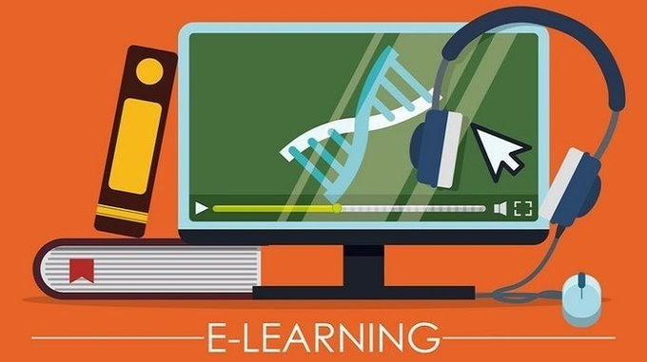

Epitome of e-learning
4. Virtual e-learning
->It uses life like scenarios techniques for training purposes. It can be used to enhance student learning and engagement through the way the content is delivered , it works on the premise of virtual world .
It can be done through this ways :
Visual field trips
High tech training
Internships
Distance learning
Group learning

Slide 11
Benefits of e-learning:
It has a positive influence on a organizational profitability , it results in improved scores on certifications , tests or any other type of evaluation .
E- learning enables educators to get higher degree of coverage to communicate the message in a consistent way to their target audience .
It is cost effective as compared to traditional form of learning , its due to as learning through this mode happens quickly and easily .
It’s away to provide quick delivery of lessons . In this the time required to learn is reduced to 25-60% of what is required in traditional learning.
In this content can be accessed unlimited number of times. The documents and lectures can be downloaded for the future reference .
It accommodates everyone’s need that is people belonging to any generation can find relatable contents to learn from.

Slide 12
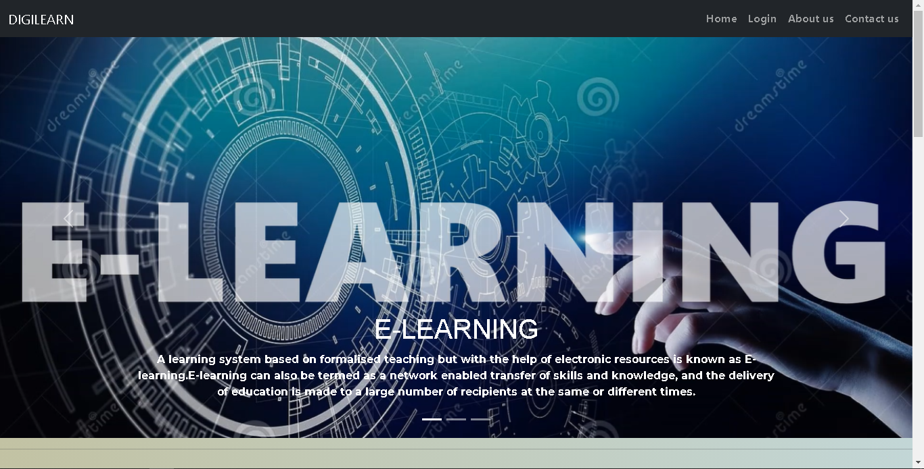
DIGILEARN

Slide 13
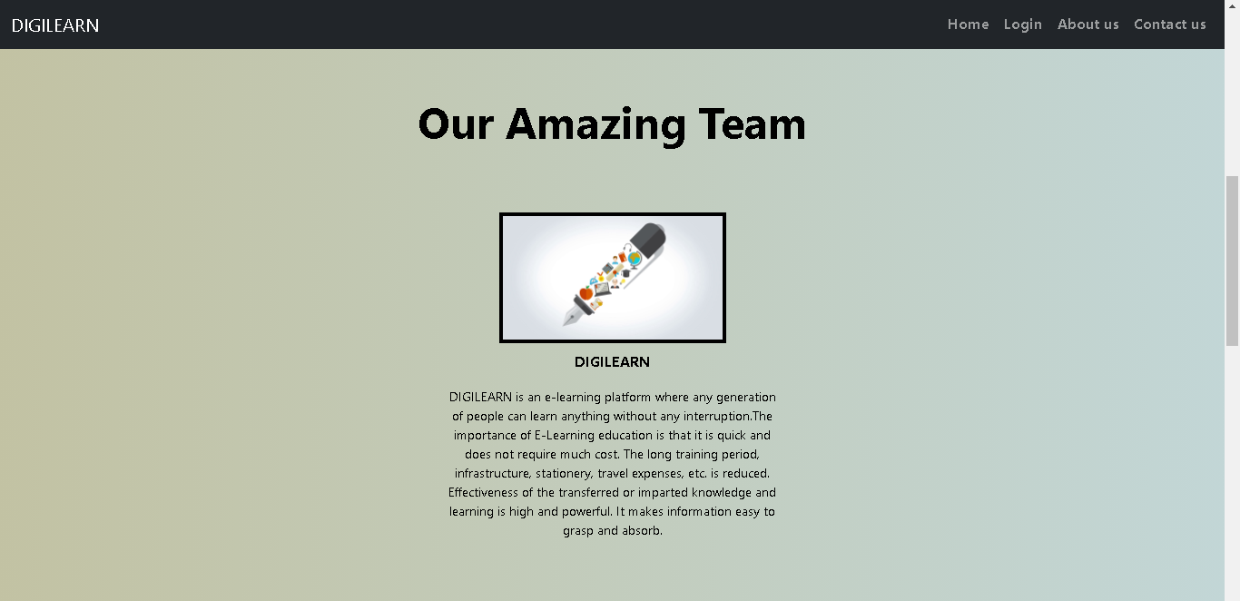
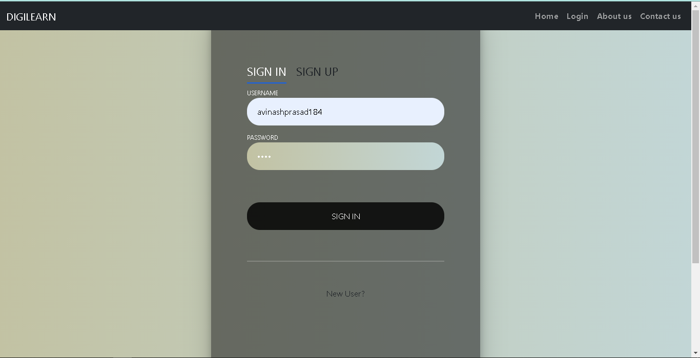
Objective of our e-learning platform - DIGILEARN as to what is that it aims to provide it’s user .
1.
First view of the platform for the registered user – SIGN IN option is made available , they have to provide username and password for access to their account .
2.

Slide 14
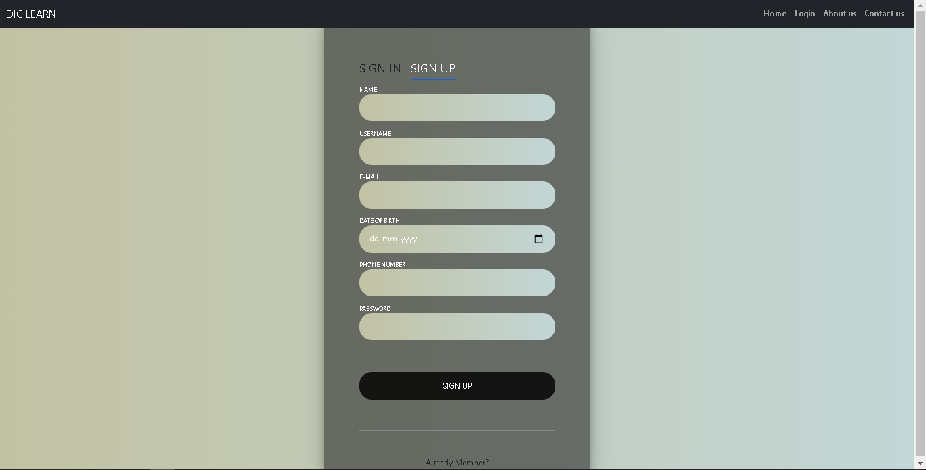
In this the user who has not registered yet will have to SIGN UP in order to get access to the DIGILEARN . They have to provide name, username , e-mail , date of birth , phone number , password . Then the user will be authorized to use .

Slide 15
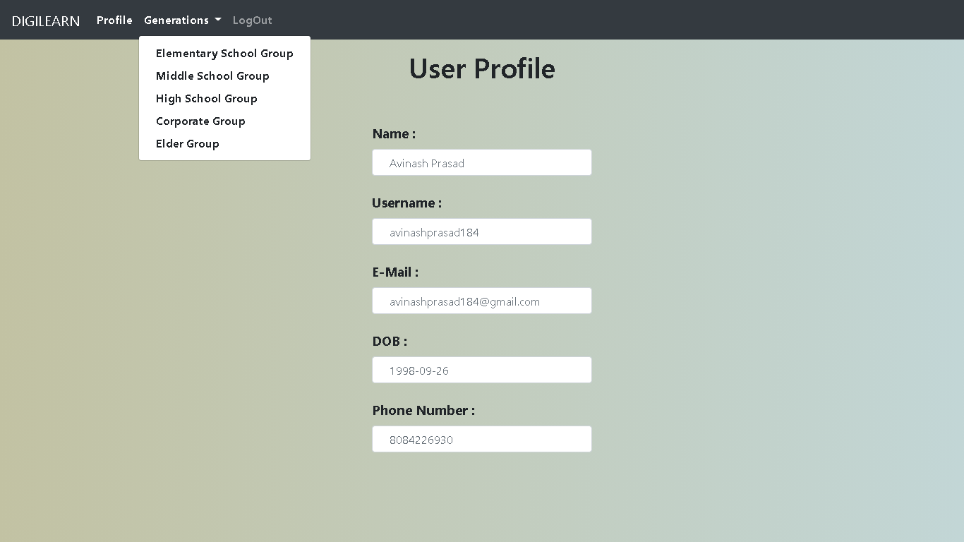
In this dashboard, user can see their own profile, and can change over to different generation topics.

Slide 16
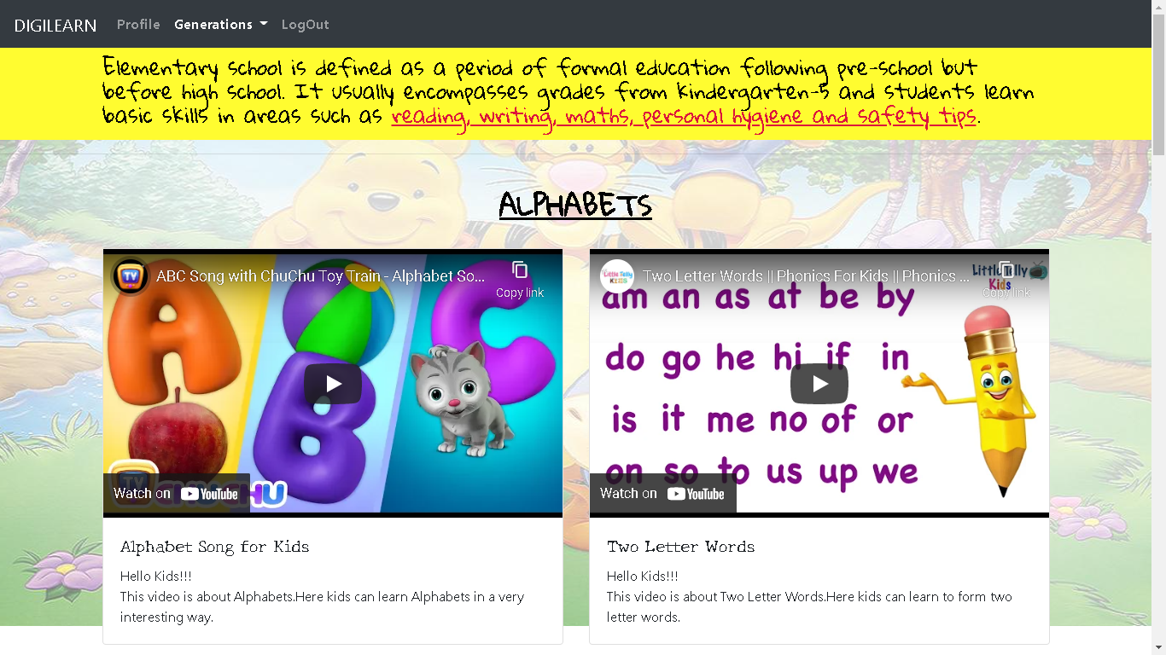
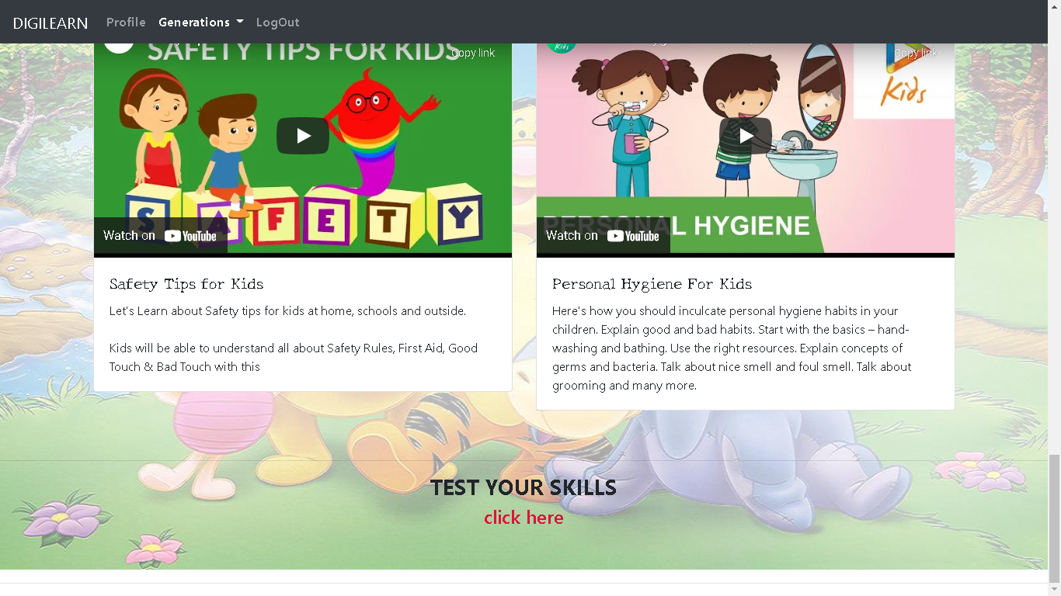
In this page, kids can learn about alphabets, numbers, rhymes, safety tips and personal hygiene. We have also included some questions to test their skills.

Slide 17
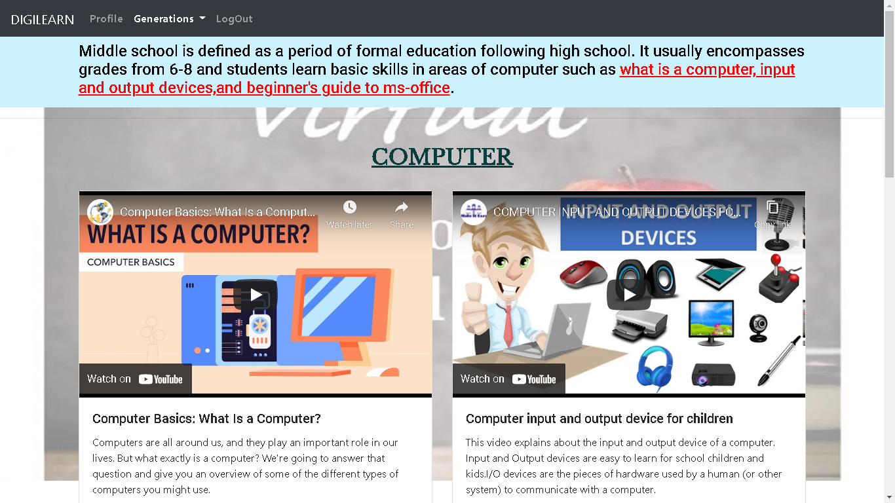
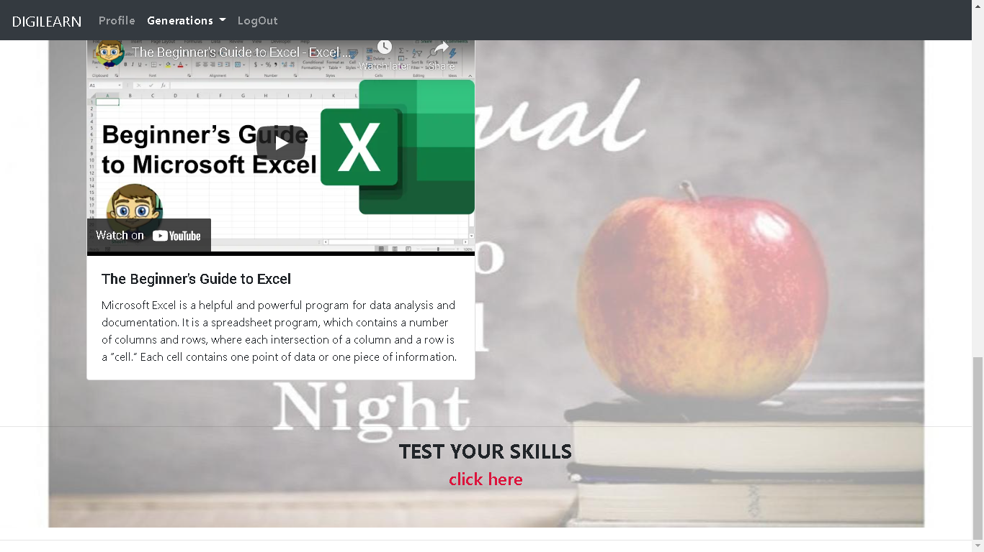
In this page, students can learn about basics computer, ms-excel, ms-word, ms-powerpoint. We have also included some questions to test their skills.

Slide 18
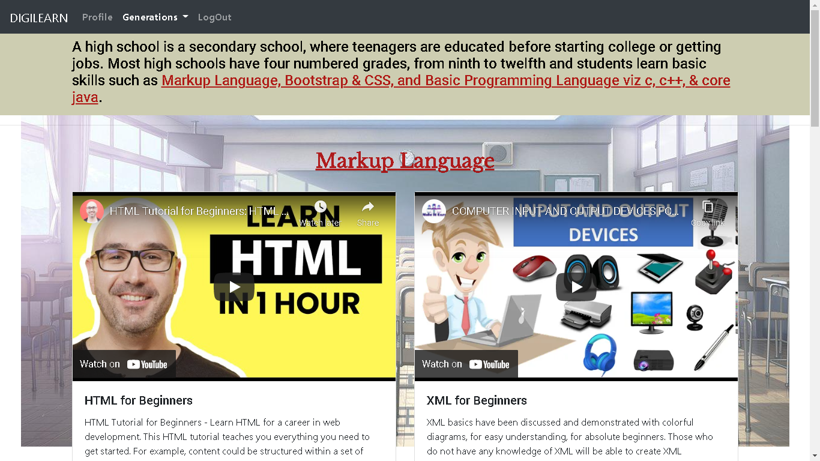
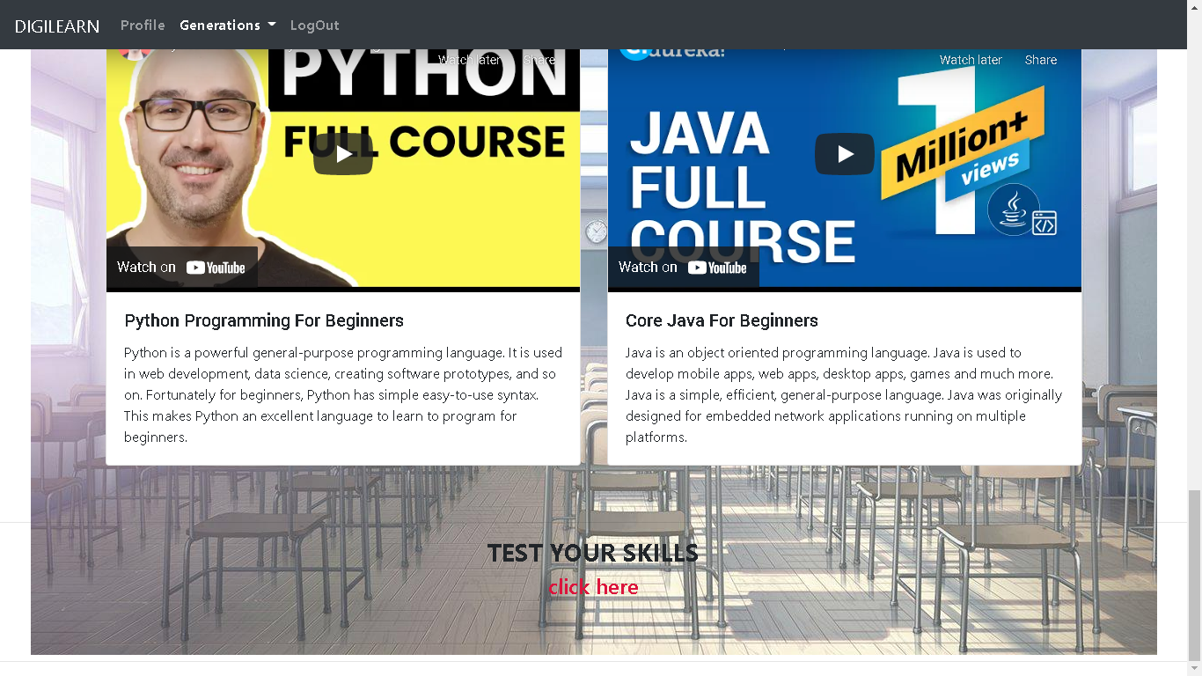
In this page, students can learn about markup language, bootstrap & css, and basic programming language. We have also included some questions to test their skills.

Slide 19
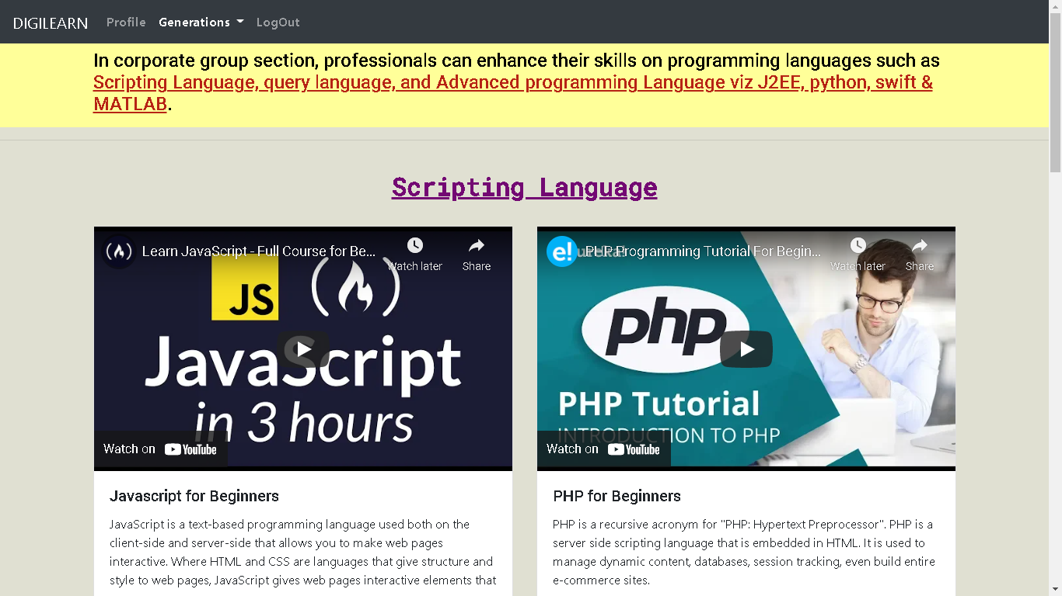
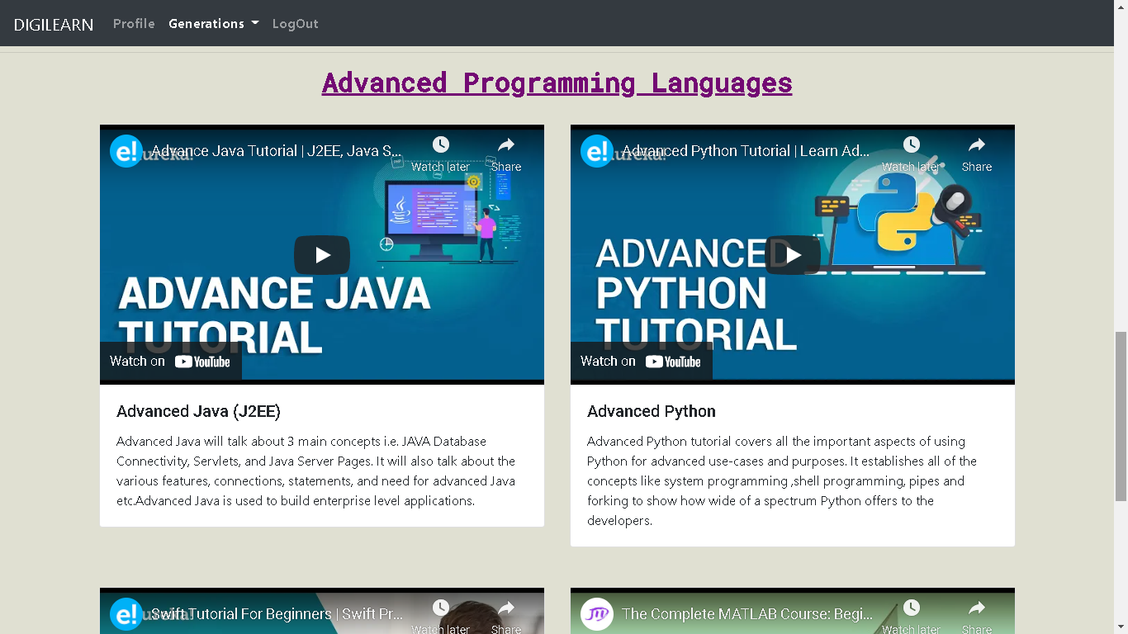
In this page, professionals can learn about scripting and query language, and advance programming language viz J2EE, python, swift, and MATLAB.

Slide 20
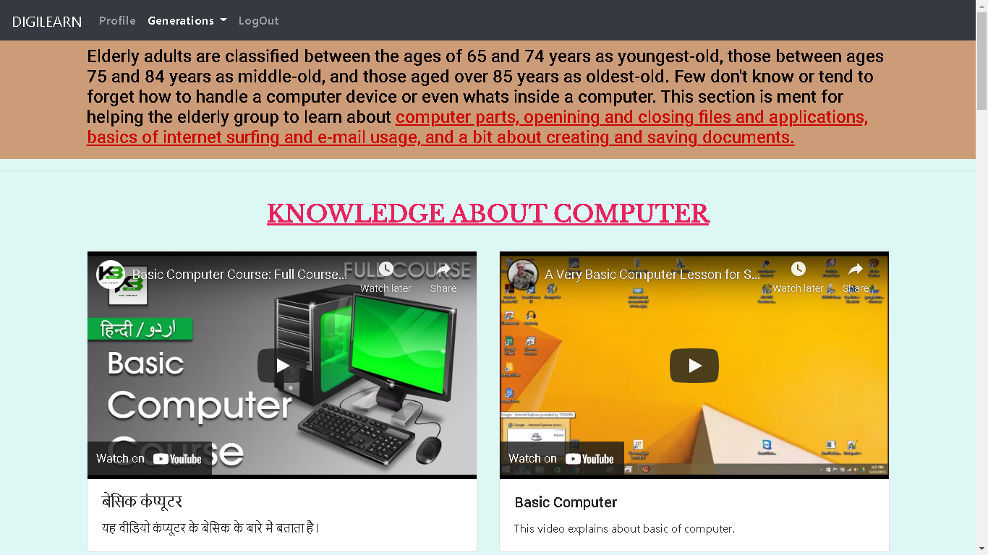
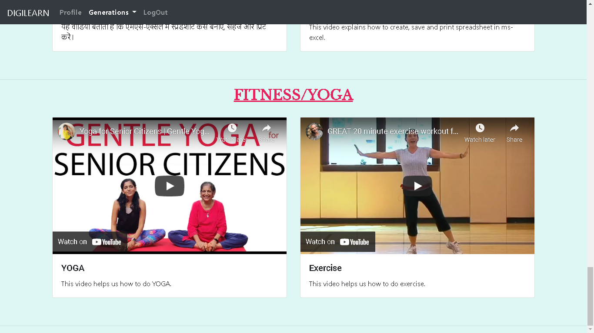
In this page, elders can learn about basics of computer, create and save document, basic of internet surfing and email usage, and fitness/yoga.

Slide 21
THANK YOU

